Slide 1
Bioinformatics （生物信息学） BME1063.01 Lecture2 Class1
张力烨
Notes:
Note: do not distribute the slides

Slide 2
week2.class1
1. Introduction about the DNA sequencing method
2. Introduction about the alignment algorithm

Slide 3
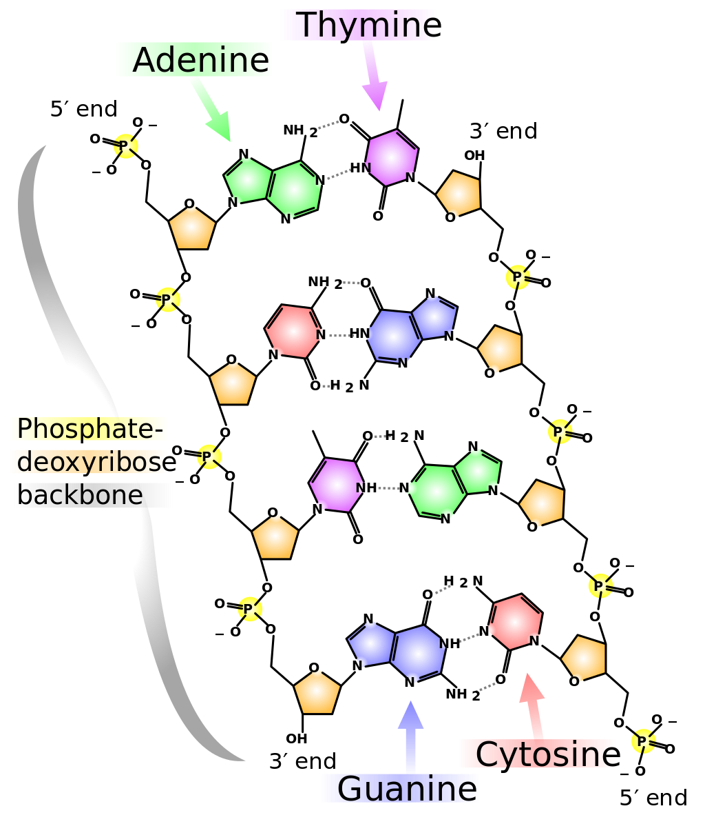
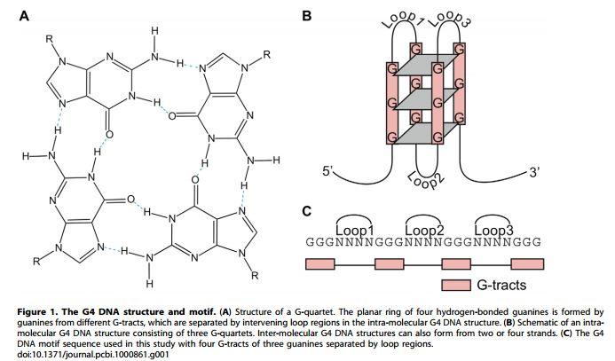
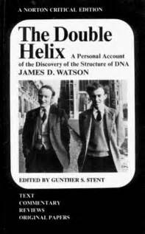
DNA basic
Capra et al, Plos Computational Biology 2010
From Wikimedia Commons, the free media repository
Notes:
4 bits (coding) can we have just 2 bits (A-T or C-G?) and why?
Too unstable or too stable (potential problem) ? G-quadruplex
The DNA is similar to 1,2,3,4 but keep in mind there its physical/chemical properties

Slide 4
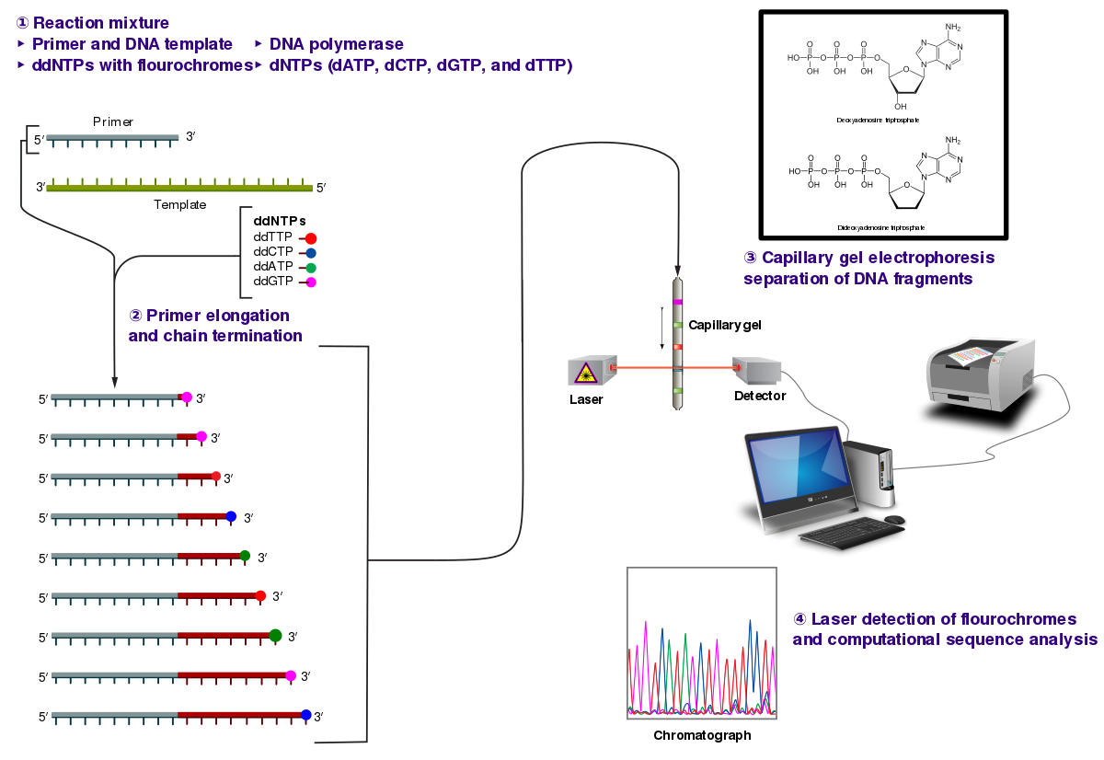
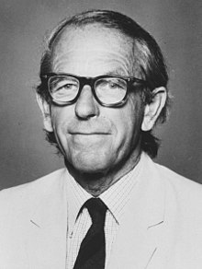
Traditional method to sequence DNA: Sanger Sequencing
From wiki
Notes:
Who can describe the method
What else does this guy do?
Techonology is very important

Slide 5
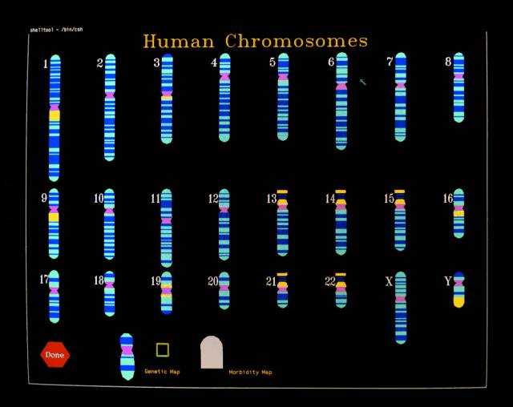

Human genome and its versions
Versions | UCSC | Ensembl
 | … | …
 | Hg18 | GRCh36
 | hg19 | GRCh37
 | Hg38 | GRCh38
hg18
hg19
Correct Mistakes
http://www.ddw-online.com/enabling-technologies/p149526-editing-the-human-genome:-role-in-functional-genomics-and-translational-medicine-summer-12.html
Notes:
Which version you should use? Concern: what is already processed.. // general the later the better. // Also the annotation files has to be consistent.
If all your data is processed in one version and you try to use processed data from another version.

Slide 6
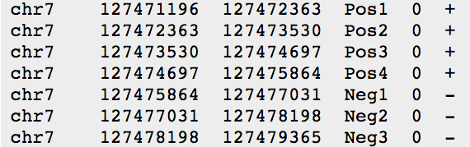
liftOver: a tool to update the reference
hg18
hg19
liftOver
Example command line:
liftOver input.bed hg18ToHg19.over.chain.gz output.bed unlifted.bed
BED format
Notes:
BED format (feature)

Slide 7
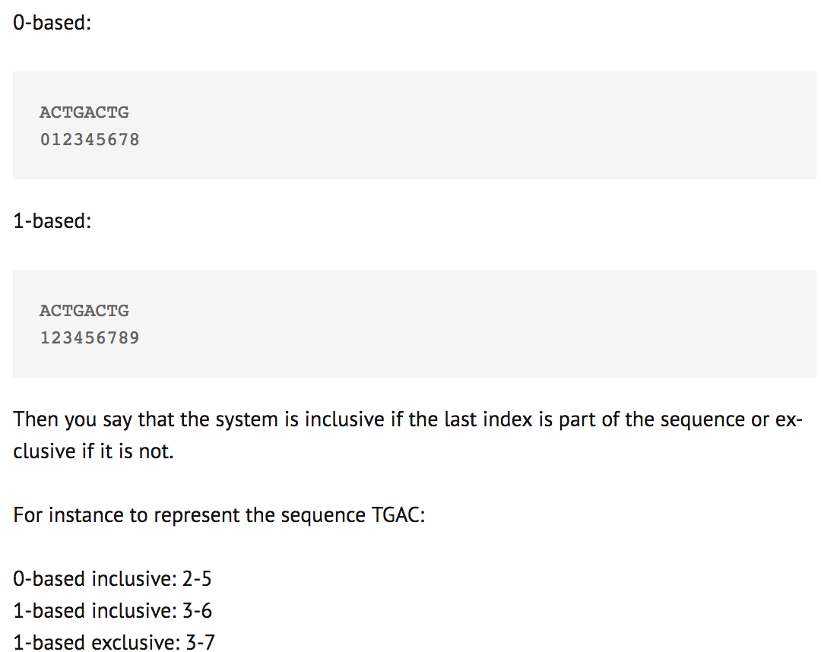
Zero or one based coordinate system
Detailed descriptions:
https://arnaudceol.wordpress.com/2014/09/18/chromosome-coordinate-systems-0-based-1-based/
Notes:
Minor things, but it may cause a problem when you perform analysis

Slide 8
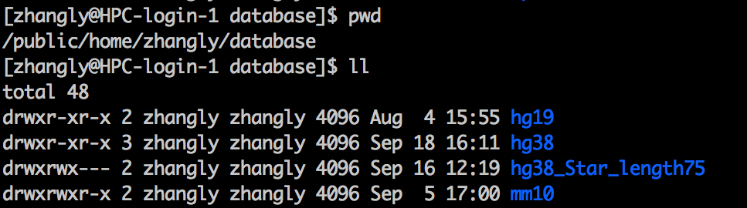
Some of the reference genomes available on the server
Notes:
Minor things, but it may cause a problem when you perform analysis
I recommend you also setup a database in your folder that shared with other people

Slide 9
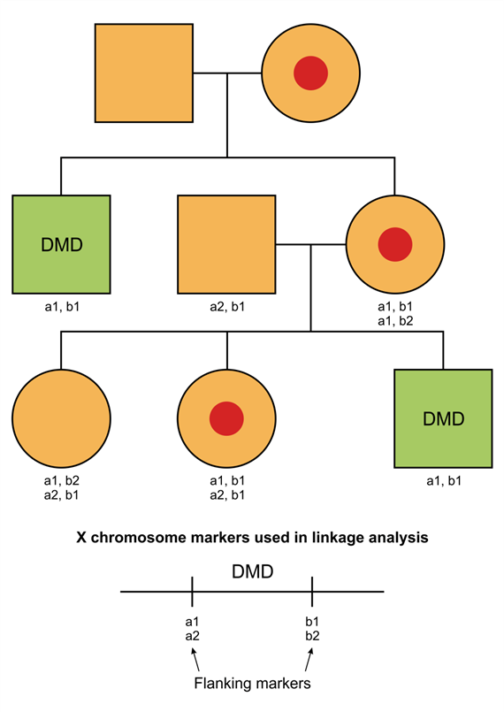
How genome sequencing can help solve Mendelian disease
http://www.tankonyvtar.hu/hu/tartalom/tamop425/0011_1A_Molelkularis_diagnoszitka_en_book/ch08.html
Notes:
1. The most successful stories came from genome sequencing of the Mendelian disease and especially rare genetic disease (most single genes)

Slide 10
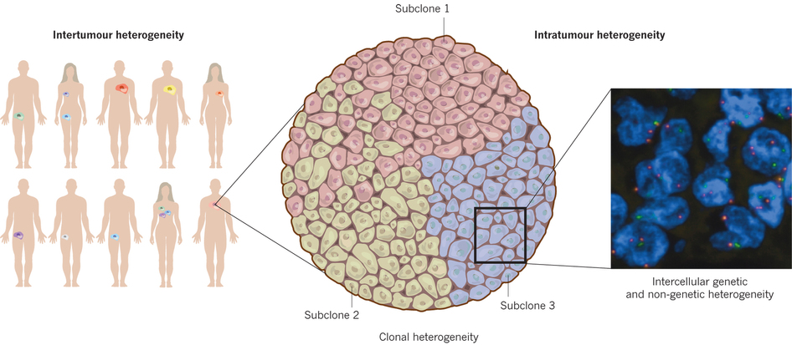
How genome sequencing can help understand cancer biology
Burrell et al. Nature 501, 338-345, 2013
Notes:
When system is complex, you need genome sequencing as well.

Slide 11
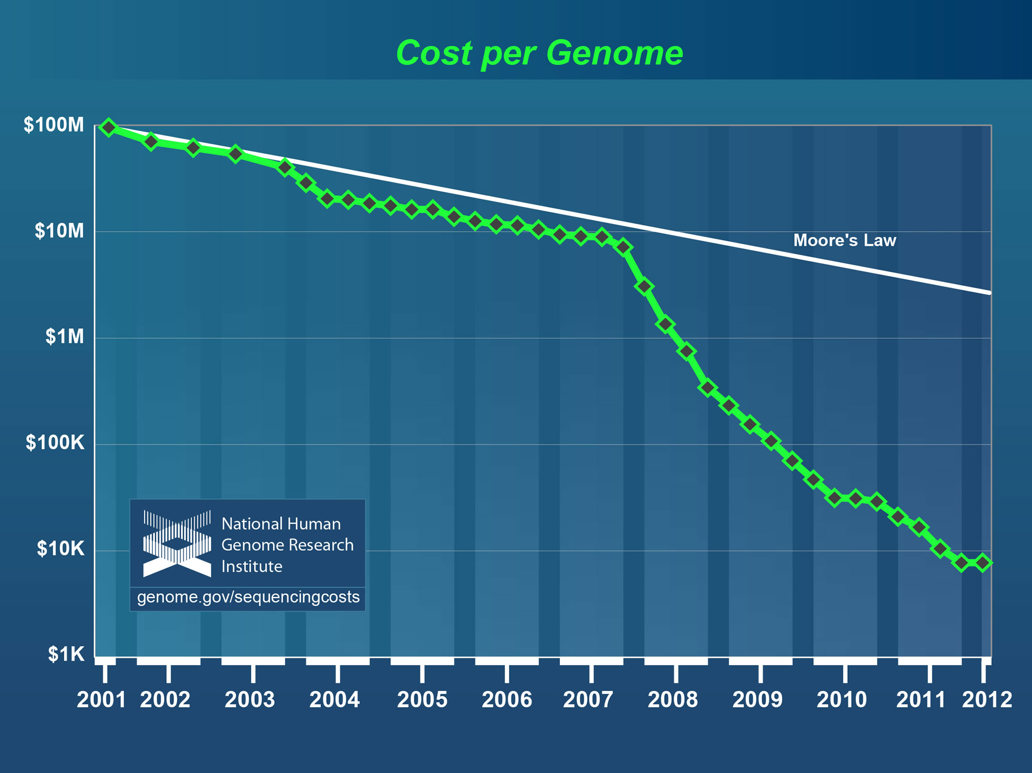
Limitation of Sanger sequencing: the cost
Genome.gov/sequencingcosts
Notes:
The decline is from solexa techology, it is not originally from Illumina, but bought by Illumina… Still not sure why Illumina can buy Solexa, but when Roche tries to buy Illumina, they failed. Maybe it is the timing issue. Or company is run.

Slide 12
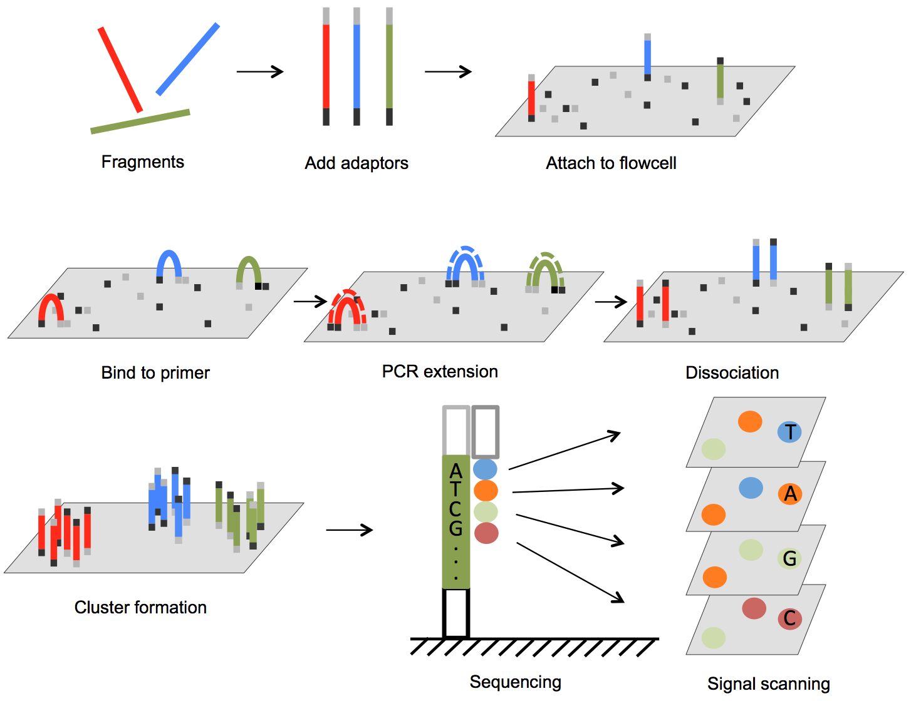
Illumina sequencing technology
Chapter2 Next Generation Sequencing in Aquatic Models, DOI: 10.5772/61657
Notes:
Solexa (

Slide 13
Common sequencing output format: fastq
@SEQ_ID
GATTTGGGGTTCAAAGCAGTATCGATCAAATAGTAAATCCATTTGTTCAACTCACAGTT
+
!''*((((***+))%%%++)(%%%%).1***-+*''))**55CCF>>>>>>CCCCCCC6

Slide 14
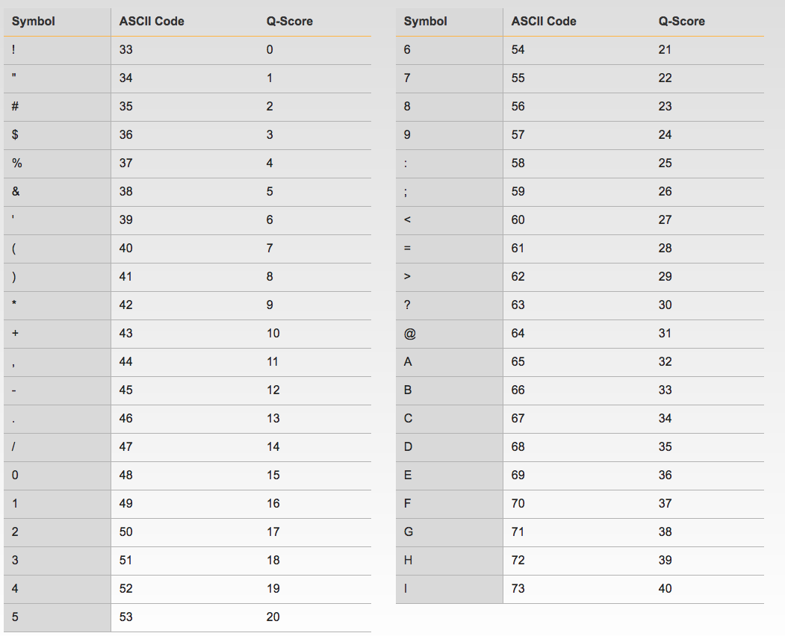
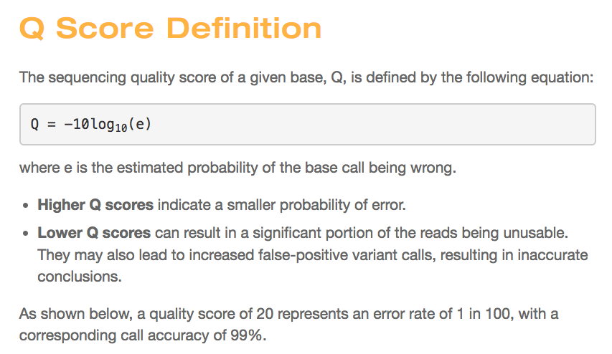
Quality score encoding (ASCII code-33)
!''*((((***+))%%%++)(%%%%).1***-+*''))**55CCF>>>>>>CCCCCCC6

Slide 15
Read length Limitation of Illumina technology
phasing
Chapter2 Next Generation Sequencing in Aquatic Models, DOI: 10.5772/61657
Notes:
There is One mistake in the video, where is the mistake?

Slide 16
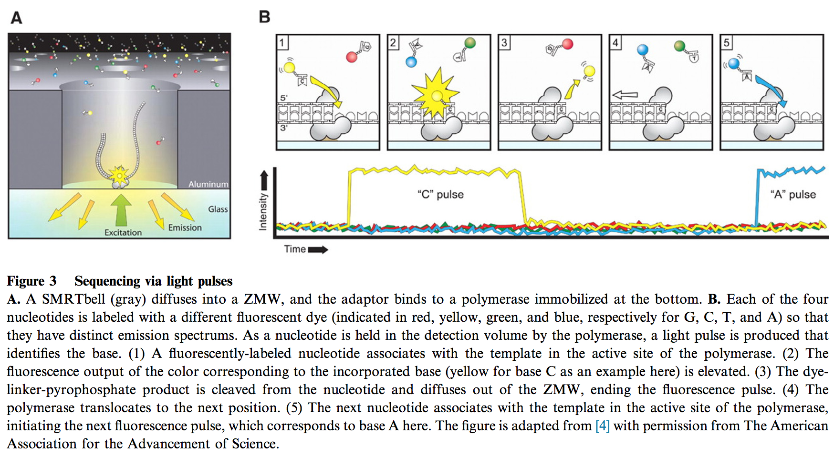
PacBio sequencing technology: single molecular
Rhoads et al. Genomics Proteomics Bioinformatics 2015

Slide 17
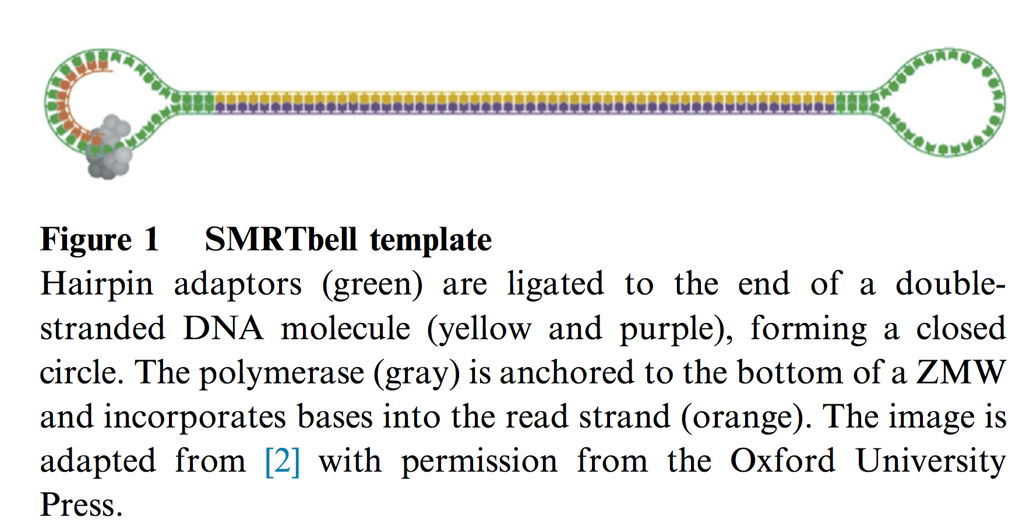
PacBio circular DNA template to allow multiple rounds of sequencing
Rhoads et al. Genomics Proteomics Bioinformatics 2015

Slide 18
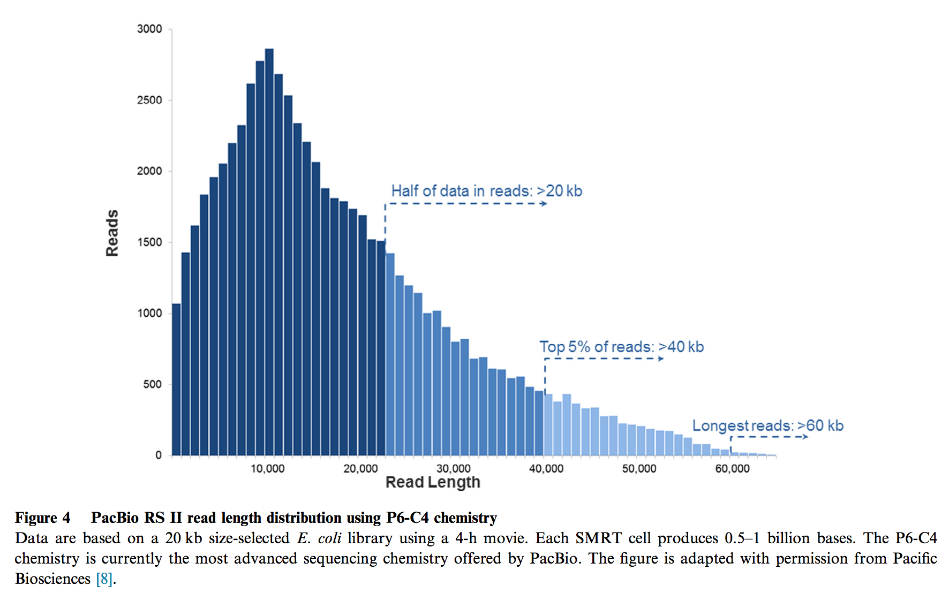
PacBio offers much longer read length
Rhoads et al. Genomics Proteomics Bioinformatics 2015

Slide 19
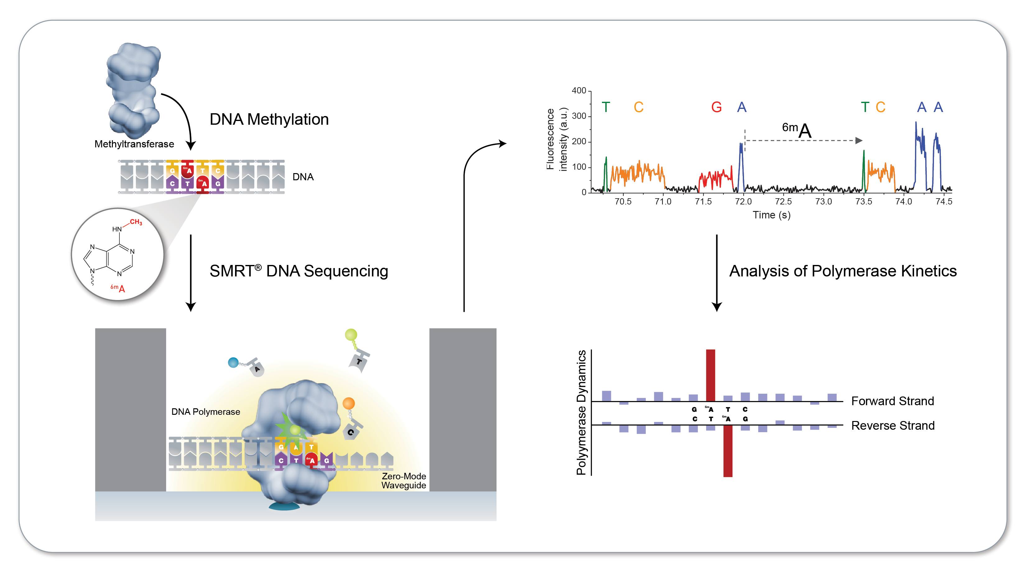
PacBio detect modifications on native DNA
Rhoads et al. Genomics Proteomics Bioinformatics 2015

Slide 20
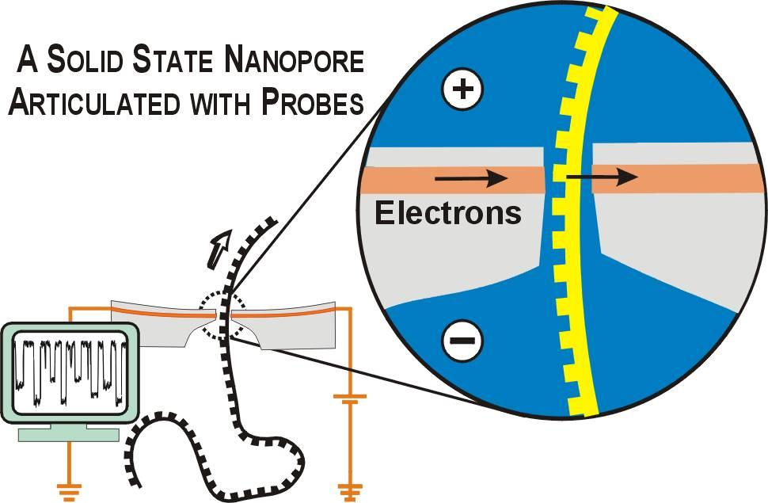
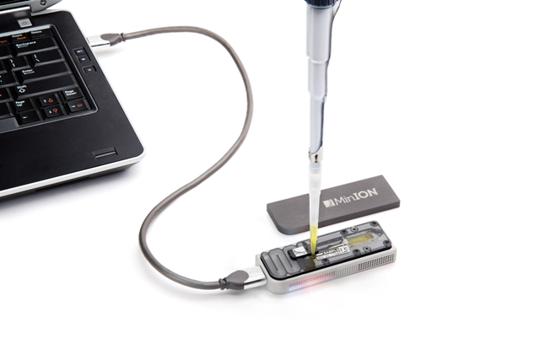
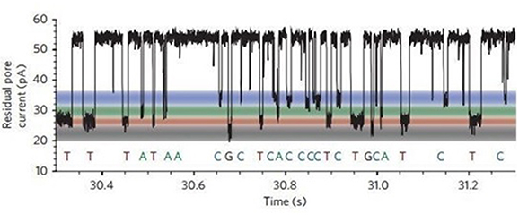
Nanopore technology
https://nanopore.physics.harvard.edu/nanopore-sequencing
Wang et al. Frontiers in Genetics 2015

Slide 21
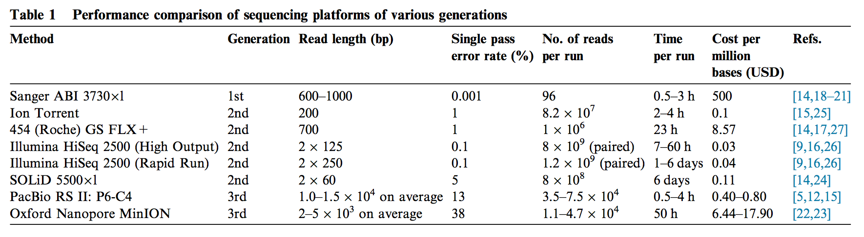
Comparison of multiple sequencing platforms
Rhoads et al. Genomics Proteomics Bioinformatics 2015

Slide 22
week2.class1
1. Introduction about the DNA sequencing method
2. Introduction about the alignment algorithm

Slide 23
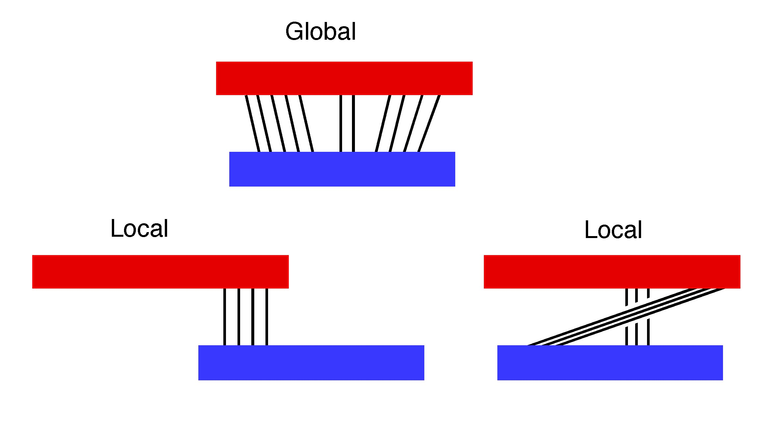
Two major types of alignment alogrithms: global and local
http://www.pitt.edu/~mcs2/teaching/biocomp/tutorials/global.html
Notes:
When do we need a global alignment algorithm and when do we need a local alignment algorithm?

Slide 24
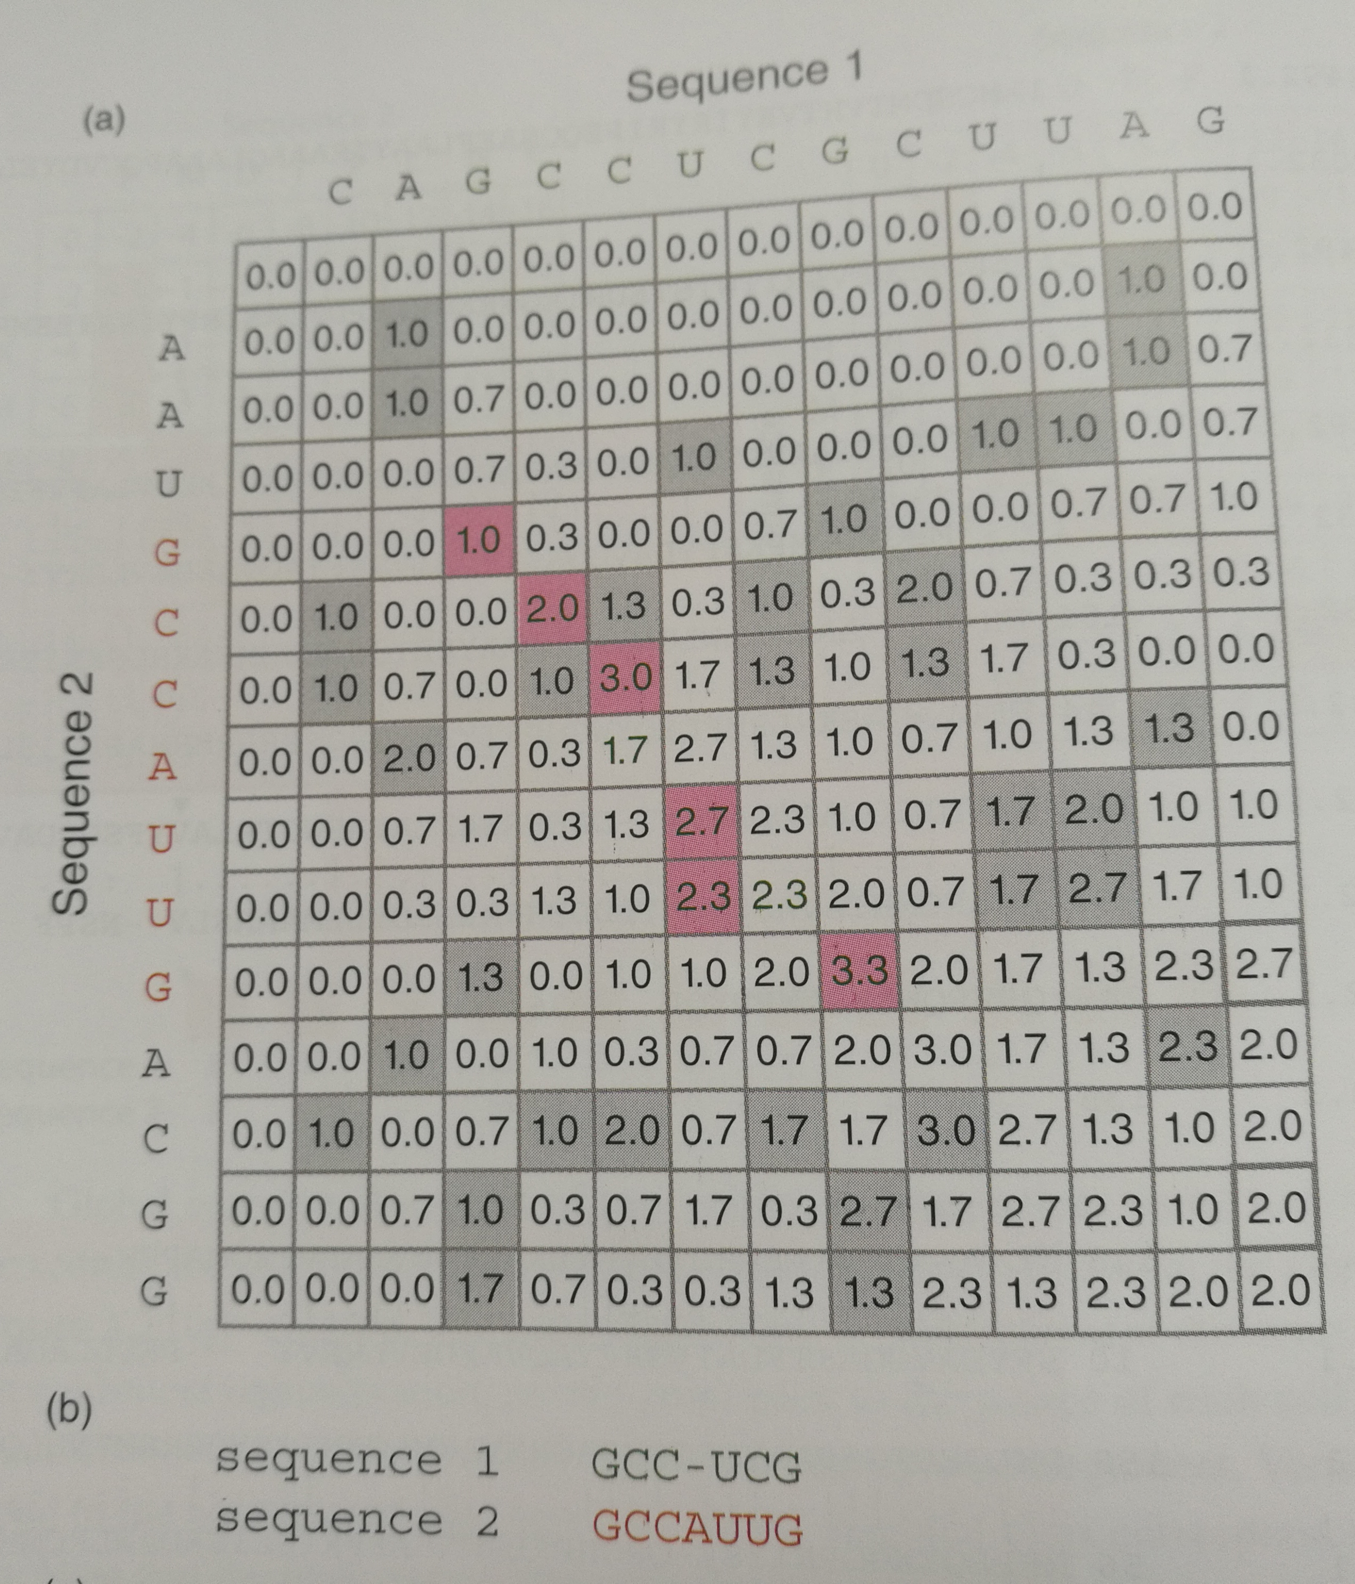
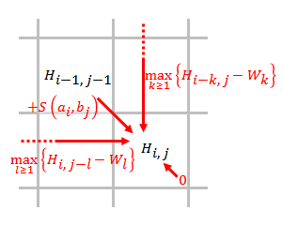
Optimal local alignment alogrithms: Smith-Waterman
Type | Score
Match | 1
Mismatch | -0.33
Gap | -(1+k/3)
Bioinformatics and Functional genomics, 3rd, page 102

Slide 25
Heuristic (do not gaurantee optimal) local alignment alogrithms: BLAST
Key difference: Divides query sequence into short words, and initially only looks for (exact for nucleotides) matches of these words, then tries extending alignment.

Slide 26
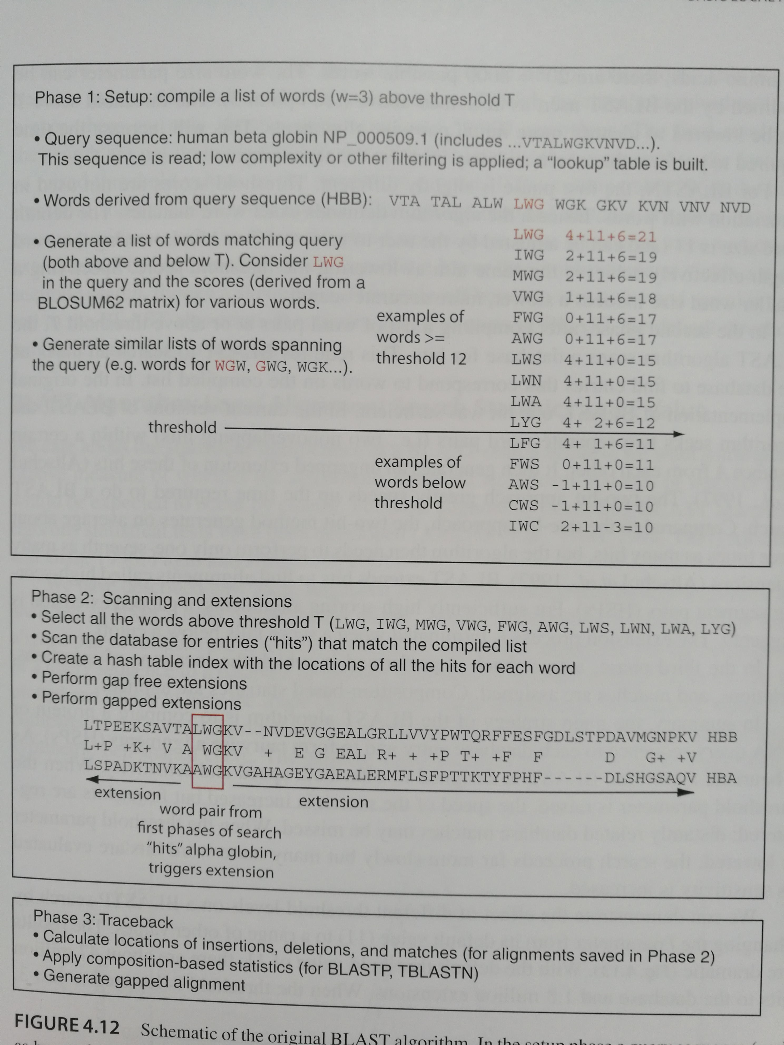
Algorithm overview of BLASTp
Bioinformatics and Functional genomics, 3rd, page 139

Slide 27
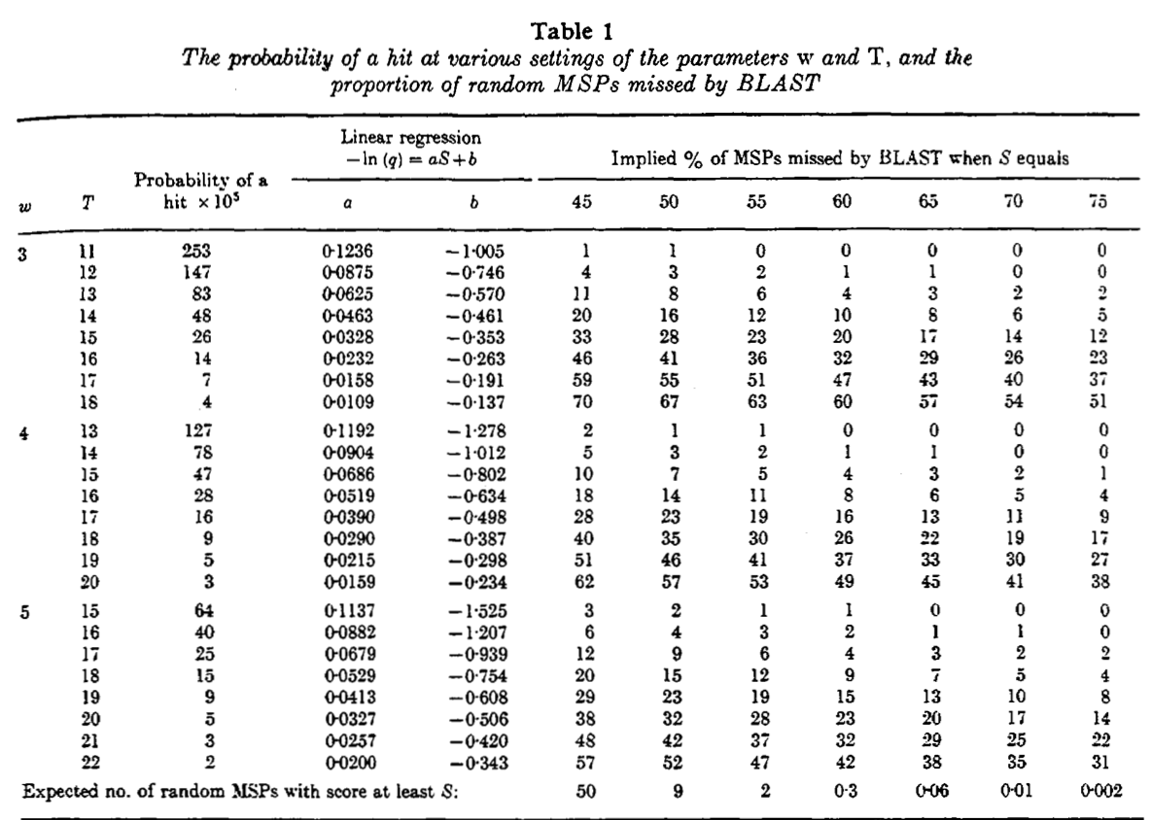
Why the w, T parameters are important?
Bioinformatics and Functional genomics, 3rd, page 139
Notes:
When you talk about any algorithm you have to consider two things: (1) how many steps (2) how much memory it has to store.
There are clever algorithm, but you need to know them as well. Understand how parameters will change the complexity of the problem..

Slide 28
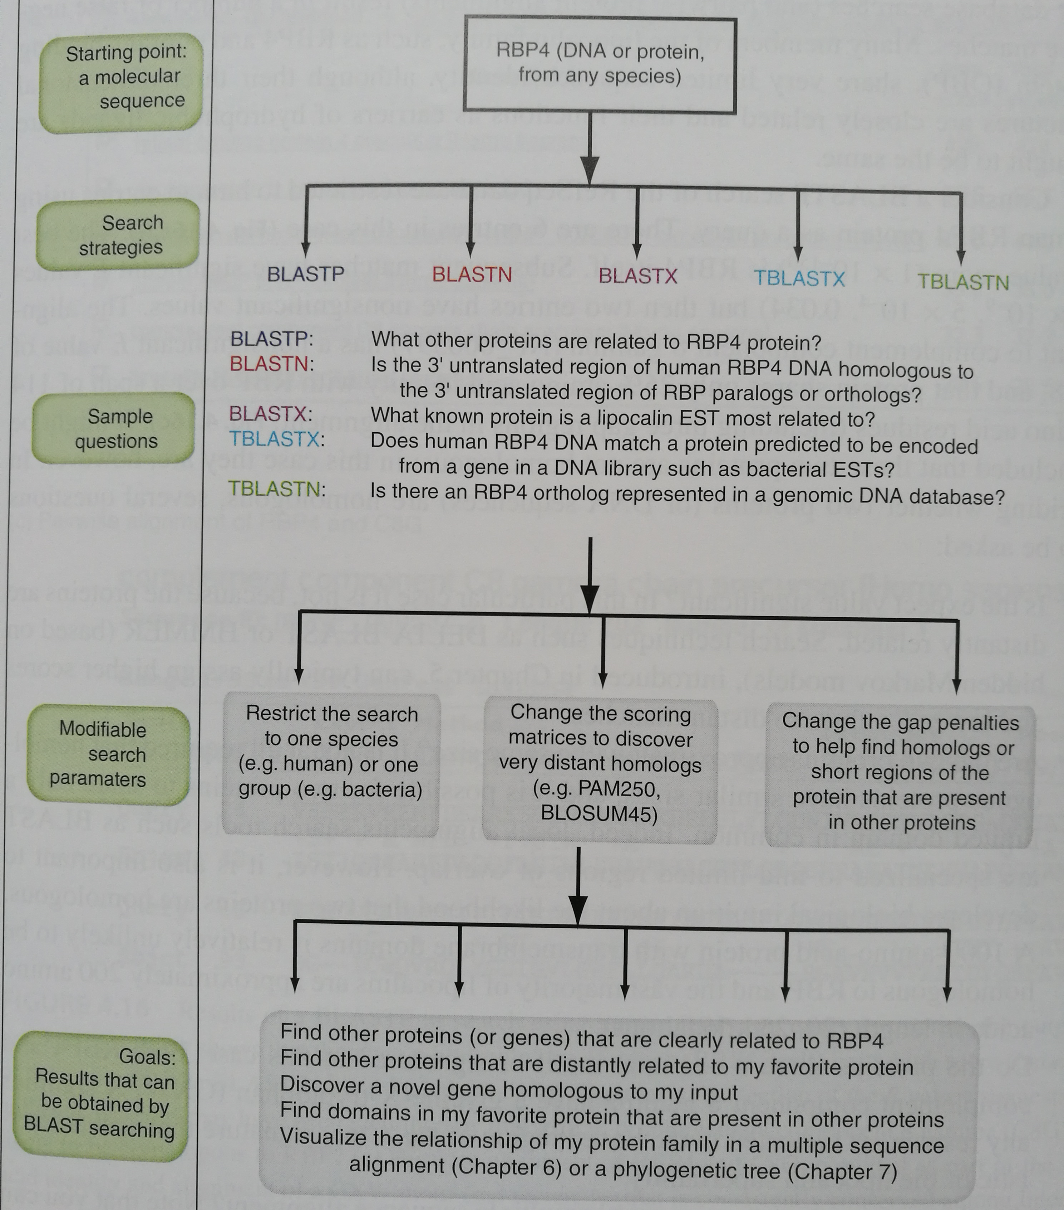
Different types of BLAST can answer different questions
Bioinformatics and Functional genomics, 3rd, page 145

Slide 29
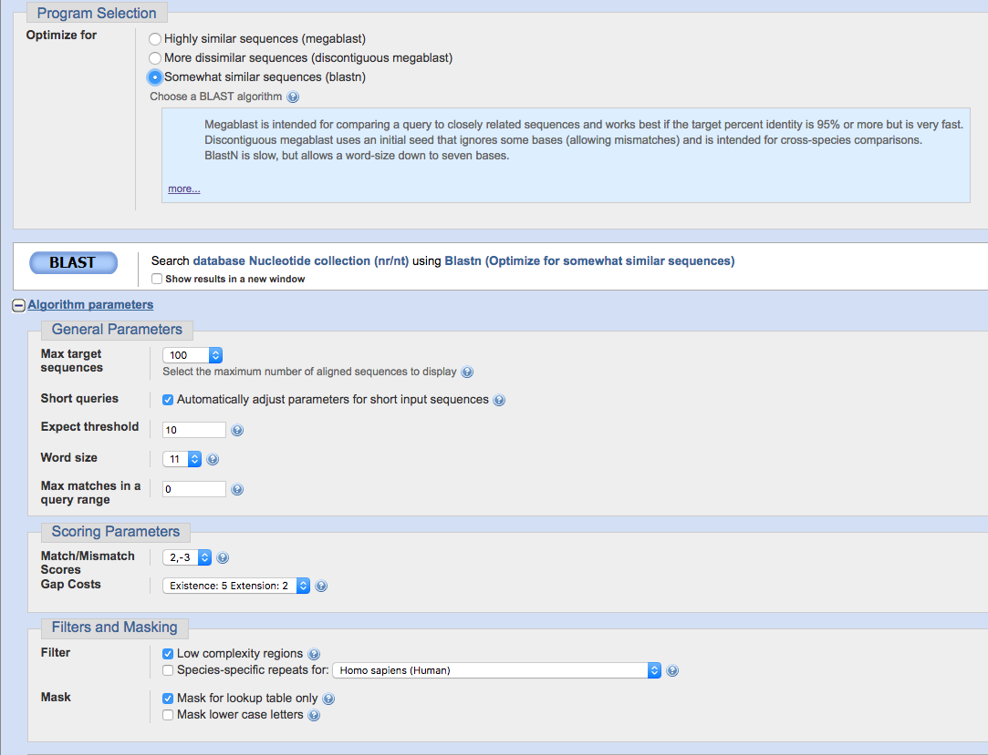
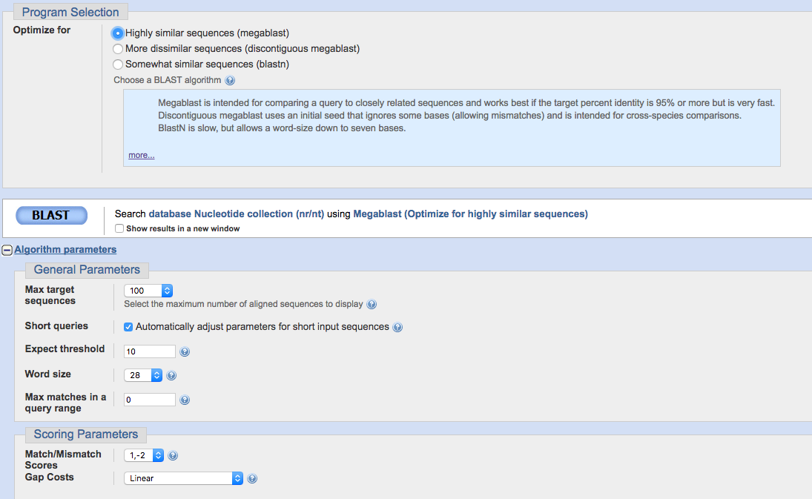
Different version of BLASTN

Slide 30
Which Blast to use?
Gene from a newly sequences species (genome)
Run Blast on DNA no significant hits were found, run blast on Protein levels, correct results were found, many hits, which parameter(s) should be tuned in here?

Slide 31
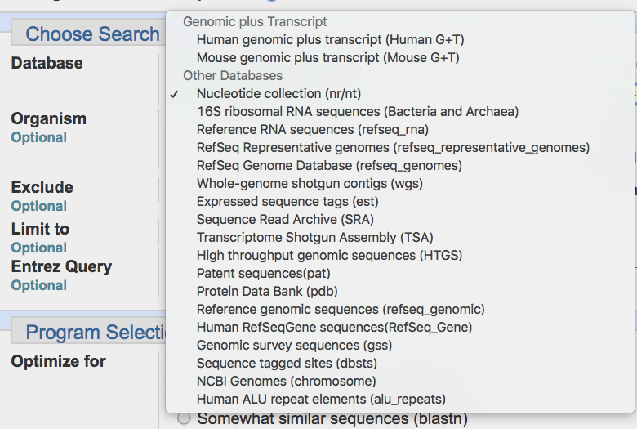
What parameters to use if you want to find genome coordinate?

Slide 32
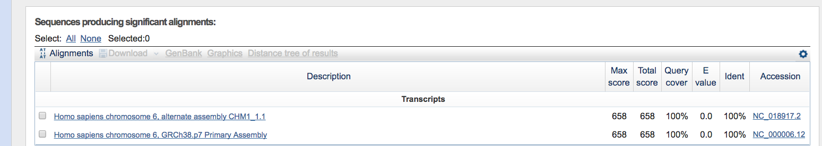
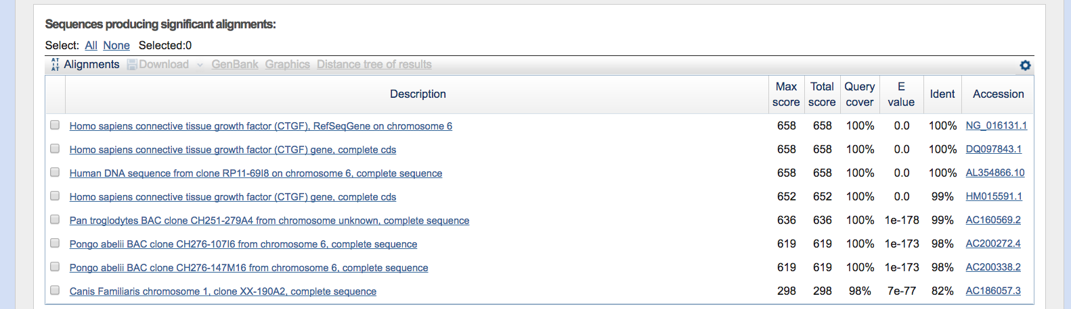
Human genome+transcripts
nr

Slide 33
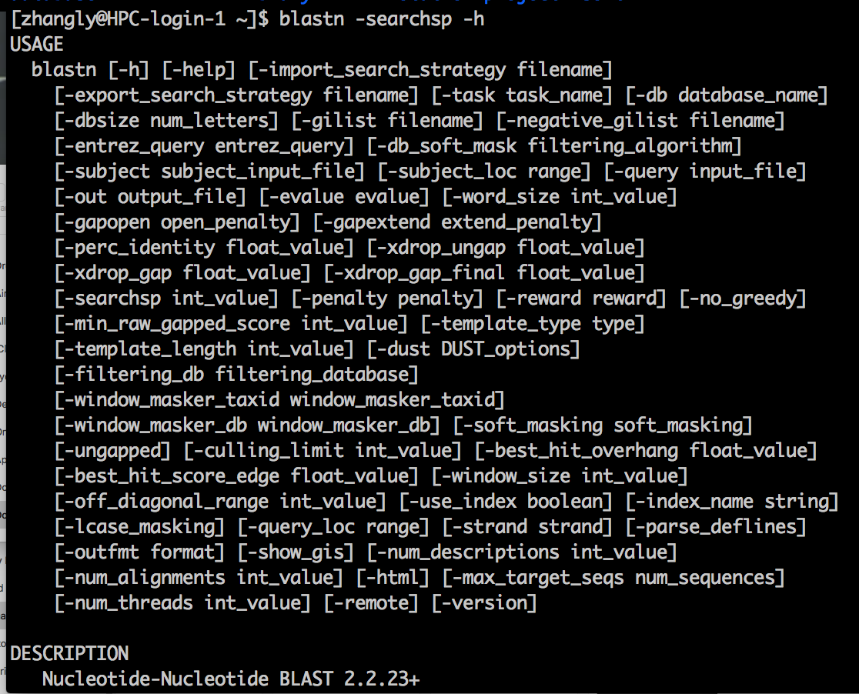
What if you want to treak more parameters

Slide 34
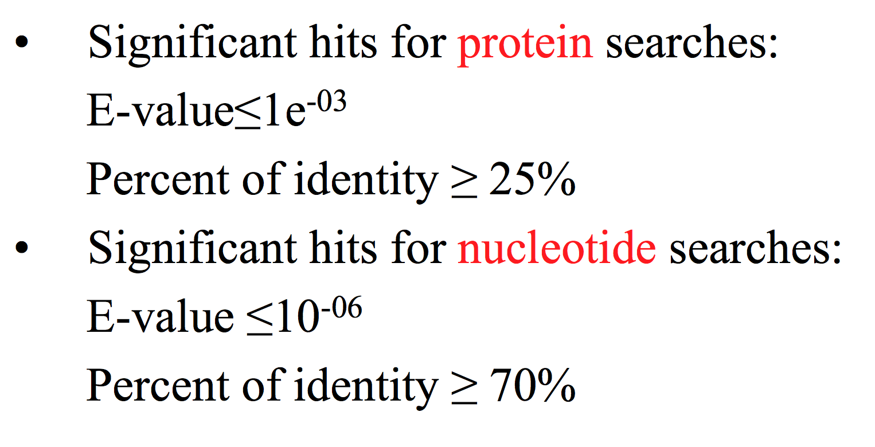
Some rules of thumbs
Slides from Teresa Przytycka, PhD

Slide 35
Take home messages for this class
1. general ideas about sequencing technologies
2. reference genome versions
3. BLAST algorithm basics

Slide 36
Backup slides

Slide 37
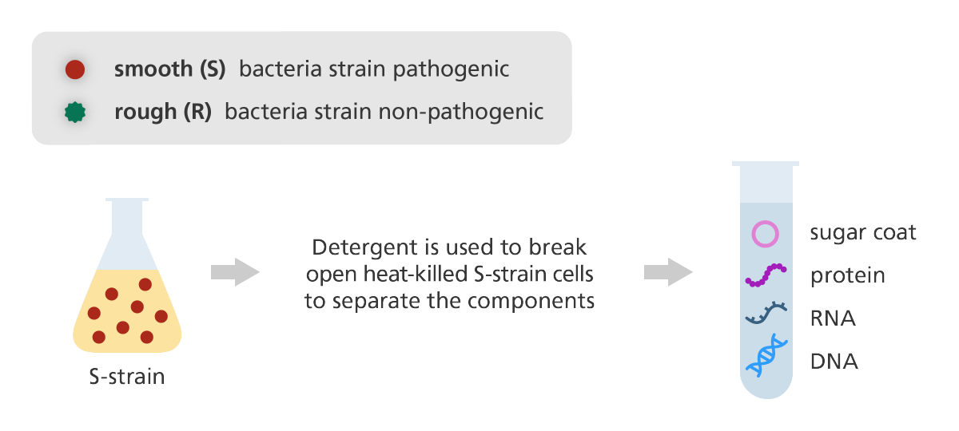
Experiments that demonstrate that DNA is genetic materials
https://www.yourgenome.org/stories/revealing-dna-as-the-molecule-of-life

Slide 38
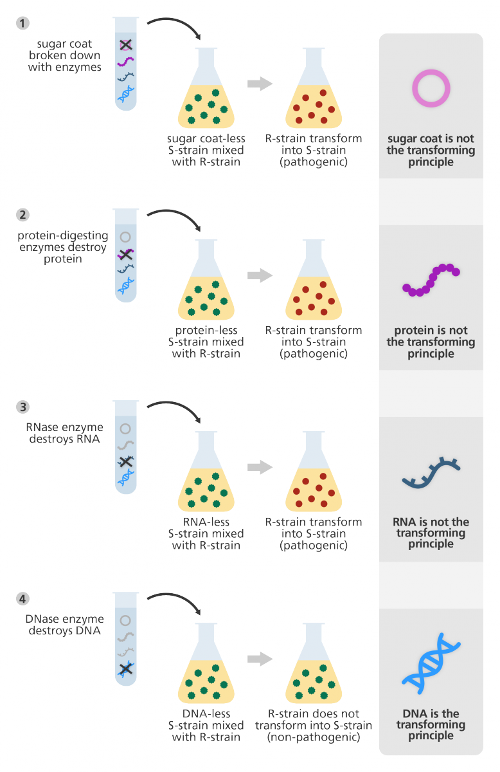
Experiments that demonstrate that DNA is genetic materials
https://www.yourgenome.org/stories/revealing-dna-as-the-molecule-of-life

Slide 39
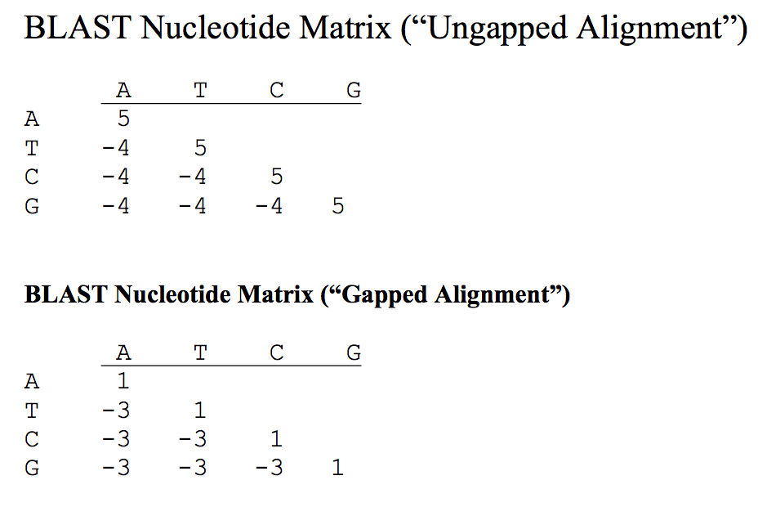
Nucleotide Scoring matrix

